Slide 1



Getting Started John Fry Parker Hornstein

Slide 2
Agenda
Overview
Getting Access
ArcGIS Portal
ArcGIS Pro
R-Bridge
ArcGIS API for Python
Machine Learning
ArcGIS Enterprise Overview
Portal for ArcGIS Demo

Slide 3

Esri
Global Leader in GIS
Serve Our Users
Advance Spatial Literacy
Contribute to Society
World’s 5th largest private software company (Software Magazine)
Financially strong American company for over 46 years
Annual Revenue > $1.4 Billion
Privately held with zero debt
3600 U.S. employees
350,000+ Customers
80 International Distributors
Supporting 130+ Countries
1800+ Partners
Reinvests >31% in R&D
$1 Billion for STEM Education
Notes:
Esri is an American company headquartered in Redlands, CA. We were founded nearly 50 years ago and support over 350,000 customers solve spatial problems. We are the world leader in Geographic Information Systems (GIS) and the fifth largest privately held software company in the world.
We aim to provide amazing tools that help solve the world’s problems. We use ArcGIS and our teams of experts to help make a positive impact on our planet. Here are just a few examples for emergency management and disaster response
At Esri, we are a research-driven company. Because we are privately owned and debt free, we spend more than 31 percent of our annual revenue on research and development so we can continue to deliver innovative technology base on our customer requirements.
Transformative technology

Slide 4

GIS Is Used By Many Organizations
1,100 National Government Agencies
2,200 States & Regional Agencies
20,000 Cities & Local Governments
30,000+ Businesses
3,300 Utilities
5,000 NGO’s
7,000 Colleges & Universities

Slide 5
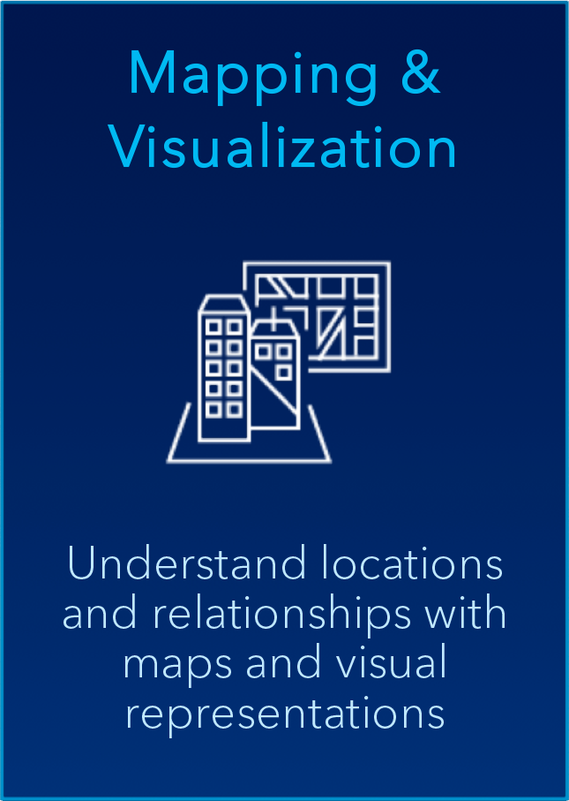
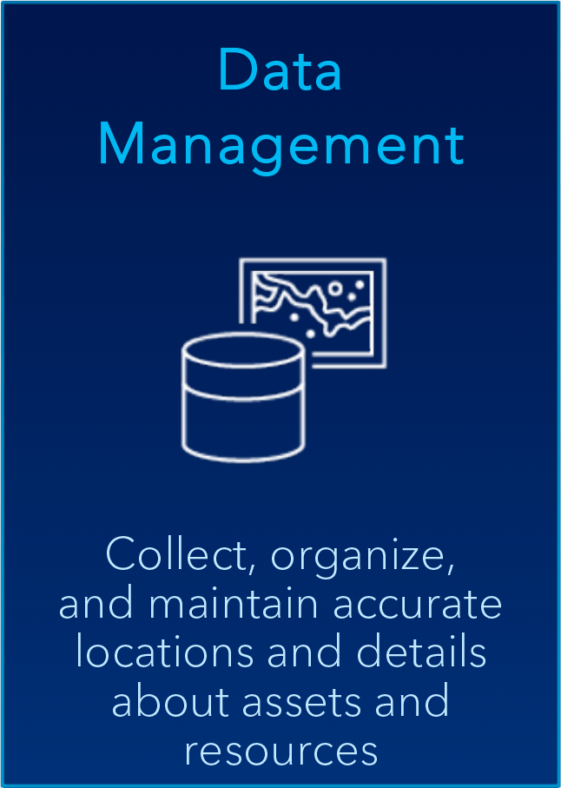
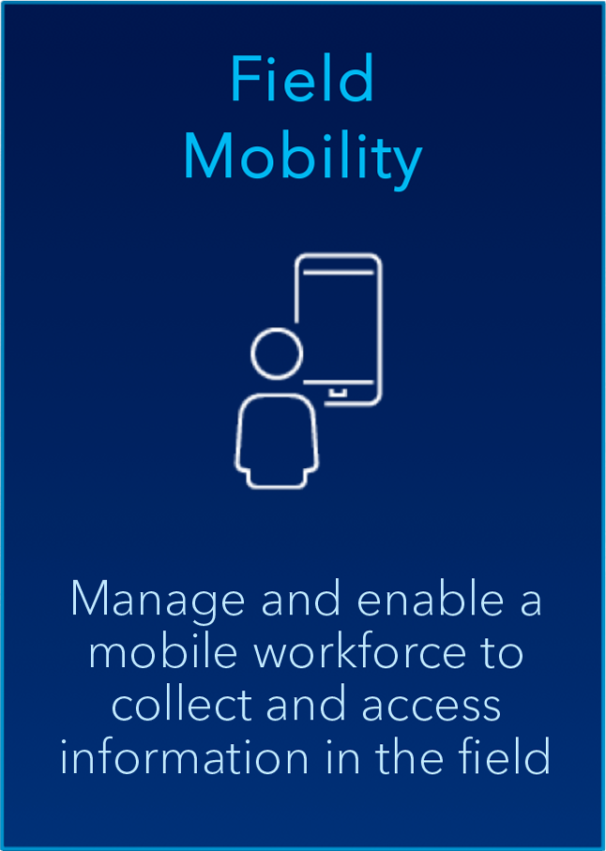







ArcGIS | Common Patterns of Use
Notes:
Chris-style

Slide 6
Getting Started

Slide 7
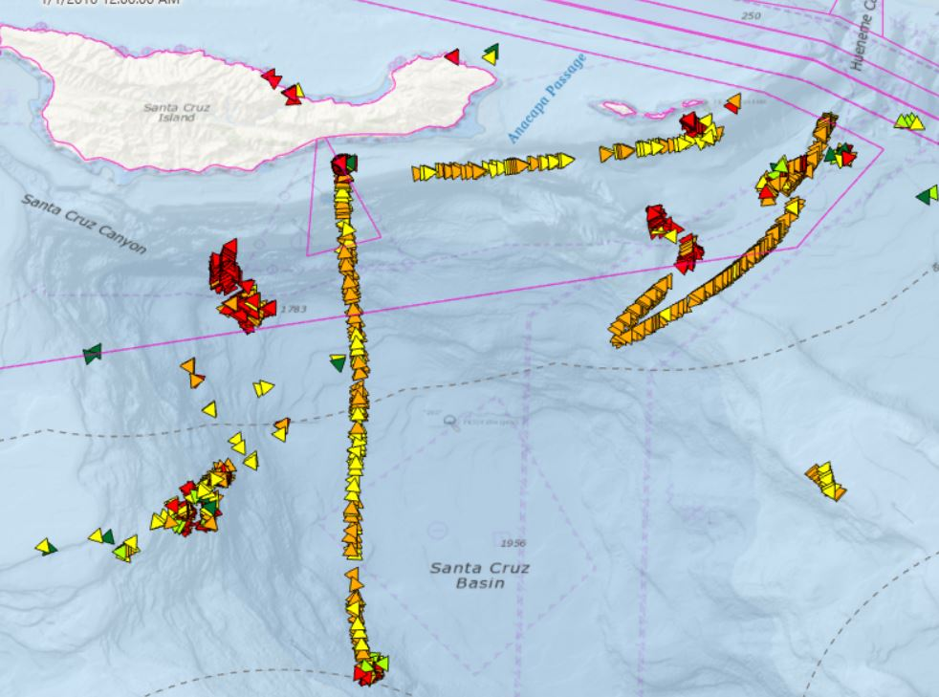

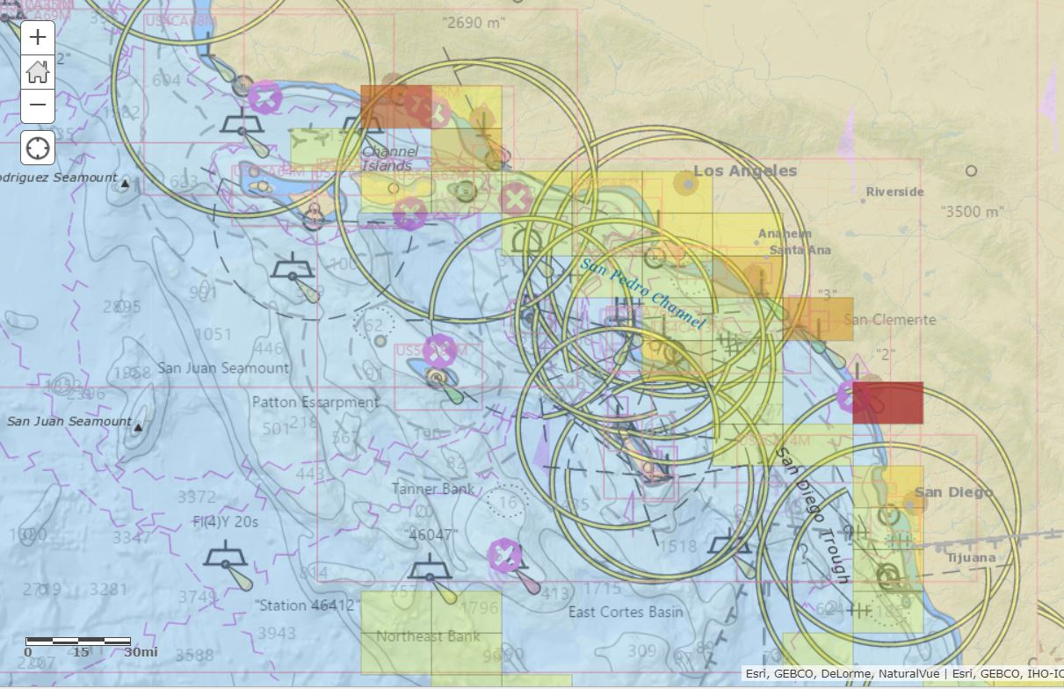
Overview
In track 2, the ArcGIS platform can be used with other software components to understand complex interactions of vessels at sea.

Slide 8

Portal for ArcGIS
Portal for ArcGIS allows users to integrate geographic data and easily create maps and applications to share to others.
Navigate to:
https://htm.esri.com/portal
Press “Sign-in”

Slide 9

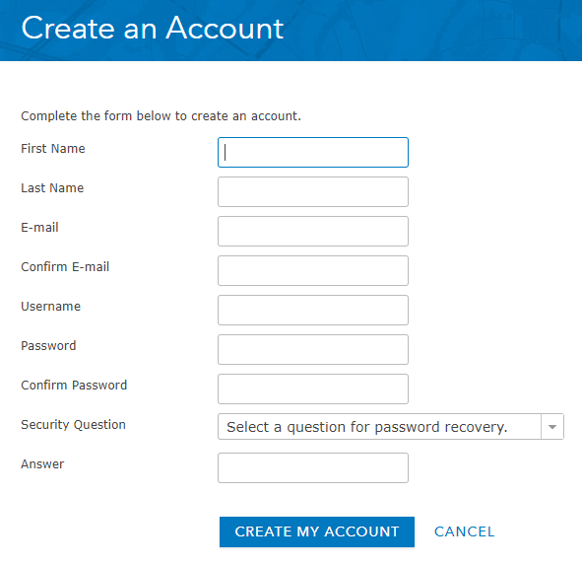
Portal for ArcGIS
By creating an account this will allow you to sign in to other applications across the ArcGIS Enterprise, such as ArcGIS Pro, and the ArcGIS API for Python
Click “CREATE AN ACCOUNT”
Fill out the details
We will give you access to ArcGIS Pro through a named user account

Slide 10
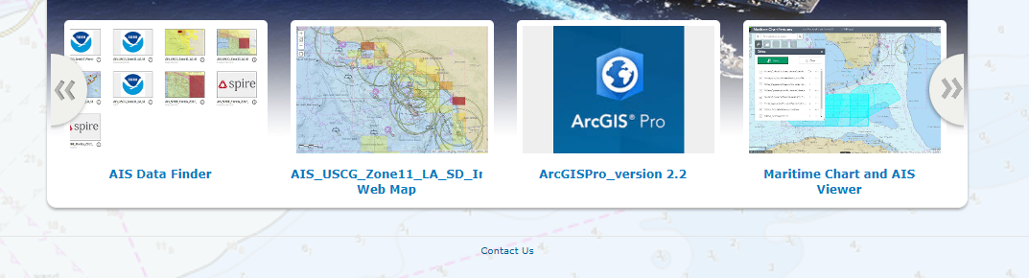
ArcGIS Pro
ArcGIS Pro is a full-featured software package to conduct Geographic Information System (GIS)
analysis and visualization
On the HACKTheMachine Geospatial Portal front page, download ArcGIS Pro

Slide 11
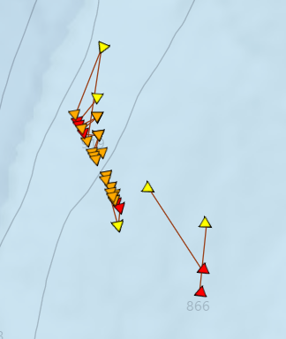
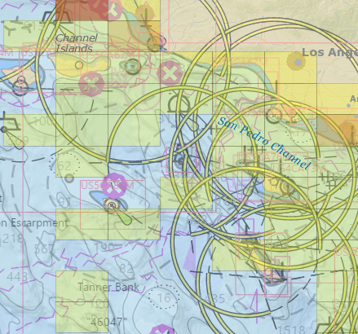



Portal for ArcGIS
Sample AIS Data
Ships carry Automatic Identification System (AIS) to provide unique identification, position, course, and speed data to other ships and shore station
There are numerous sample data included in the Portal for ArcGIS

Slide 12
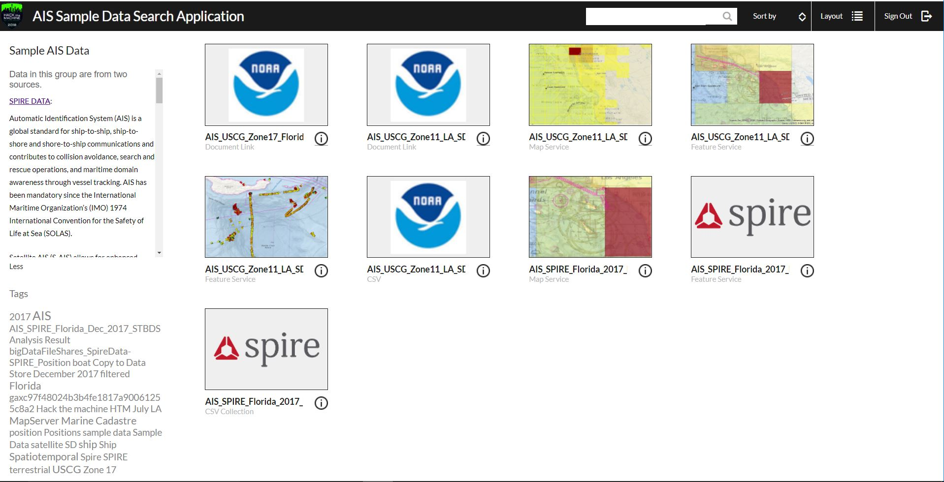
Portal for ArcGIS
Sample AIS Data
The application “AIS Data Finder” presents the sample data
Can search of choose by the tag cloud
Original CSVs from source (NOAA, SPIRE)
Feature Services from processed data
View data and export selected AIS from “Maritime Chart and AIS” application

Slide 13
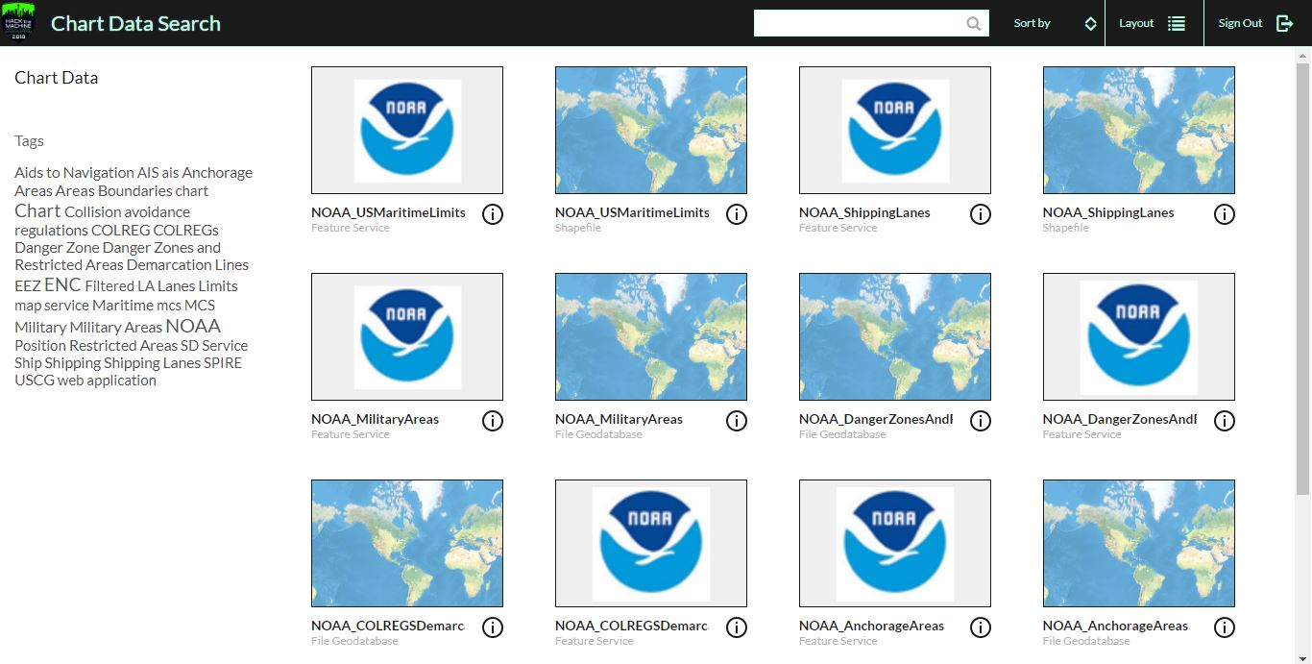
Portal for ArcGIS
Sample Chart Data
The application “Chart Data Search” presents chart data
Can search of choose by the tag cloud
Original shapefiles and file geodatabase from source (NOAA)
View data and export selected AIS from “Maritime Chart and AIS” application

Slide 14
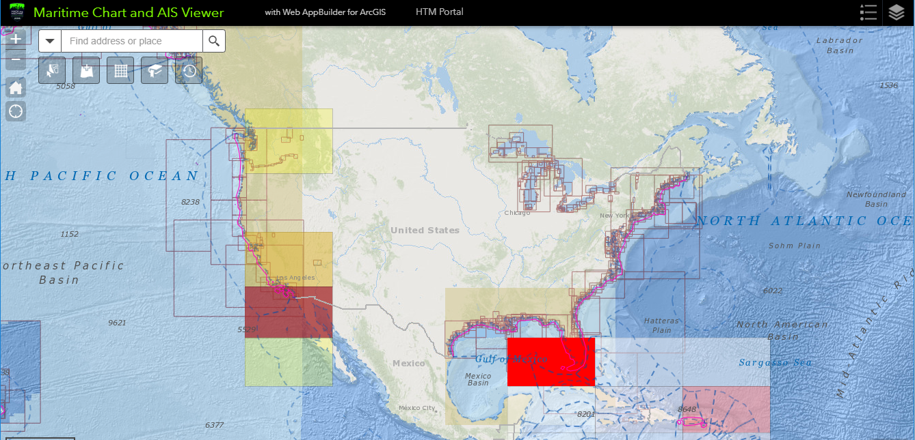
Maritime Chart and AIS Viewer Application
View AIS and Chart Information
The application “Maritime Chart and AIS Viwer” presents chart data and AIS
Turn on and off layers
As you zoom in, layers appear
AIS will change bin – darker reds are higher density
Select button allows you to select features and export them

Slide 15
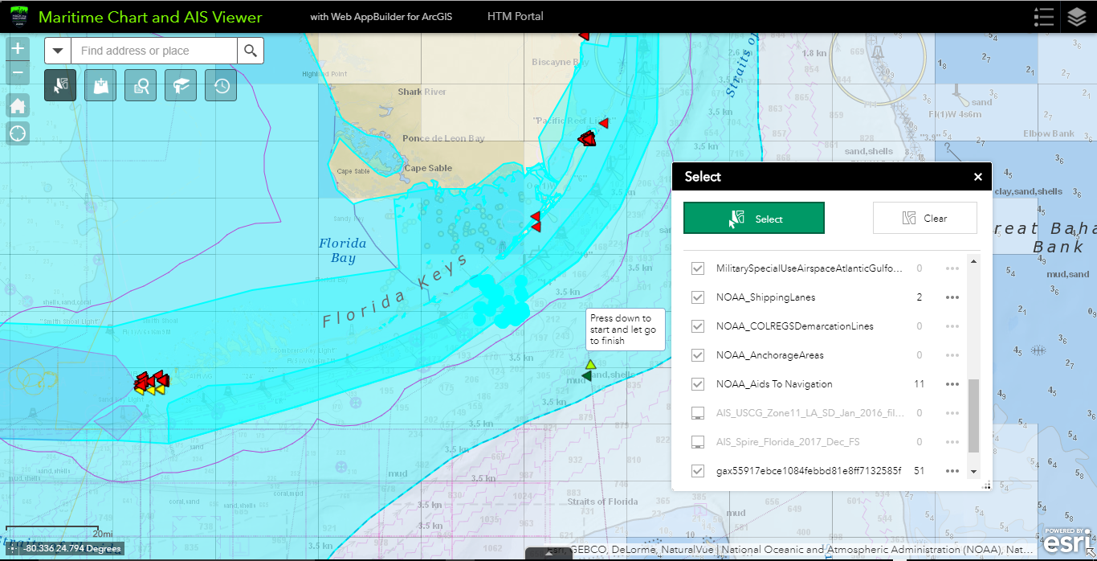
Maritime Chart and AIS Viewer Application
View AIS and Chart Information

Slide 16
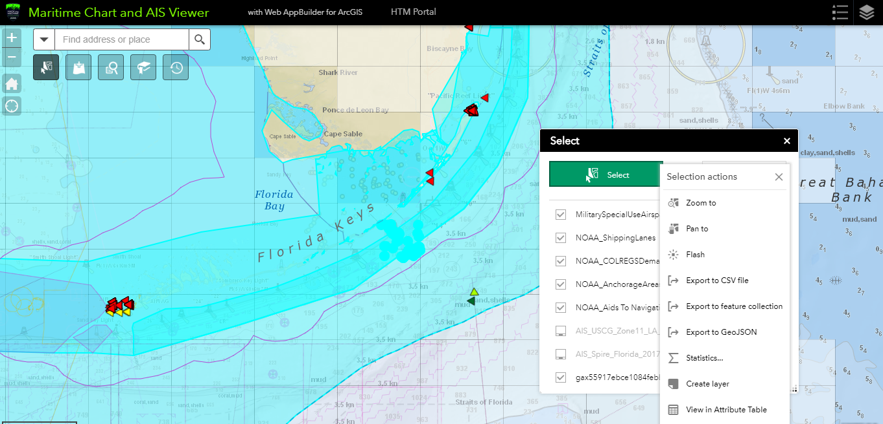
Maritime Chart and AIS Viewer Application
View AIS and Chart Information

Slide 17
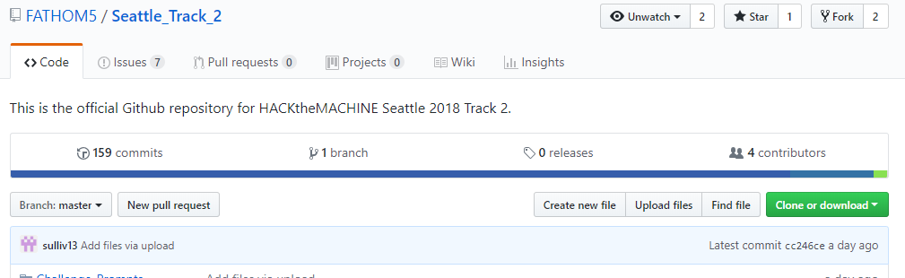
Github
Access to repo allows you to download the AIS data as well
https://github.com/FATHOM5/Seattle_Track_2

Slide 18
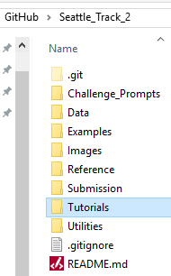
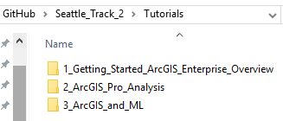
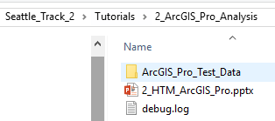
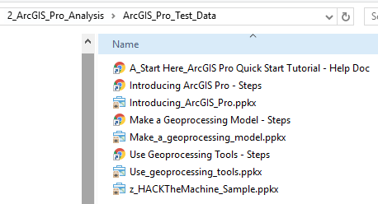
Github
Access to repo – ArcGIS Tutorials and Sample Data

Slide 19
Why Use R?
The R Language
R is a free and open-source programming language.
Designed with data analysis in mind
Powerful core data structures and operations
Unparalleled breadth of statistical routines
Both cutting-edge research and field specific methods
CRAN: Over 12,700 available packages (doubled since 2016!)
Versatile and powerful plotting

Slide 20
R Spatial Packages
Connecting R to spatial
Spatial data has a strong support framework
Well-defined classes and methods for vector and raster data
Consistent handling across the language
Functions for simple tasks, like plotting, subsetting, and summarizing spatial objects
Functions for advanced, niche spatial analyses
Interfaces well with ArcGIS
Working with feature data (points, lines, areas):
Historically sp has been the main package for working with feature data
New effort going into the sf package, which contains more extensive integration, and a richer underlying data model
100s of packages have interop

Slide 21
Introducing the R-ArcGIS Bridge
The R-ArcGIS Bridge
The R-ArcGIS bridge allows you to connect ArcGIS to R and enables the seamless transfer of data back and forth, along with the ability to integrate R and ArcGIS functionality.
ArcGIS

Slide 22
Vector Support
Points
The R-ArcGIS Bridge
Ability to read and write vector data
Support for key R objects and spatial packages
R data frame object
Compatibility with sp
Compatibility with sf
Customize data manipulations
Craft SQL queries to make selections
Subset by specific columns
Reproject data as needed
Maintain spatial geometries when working with dplyr
Lines
Polygons

Slide 23
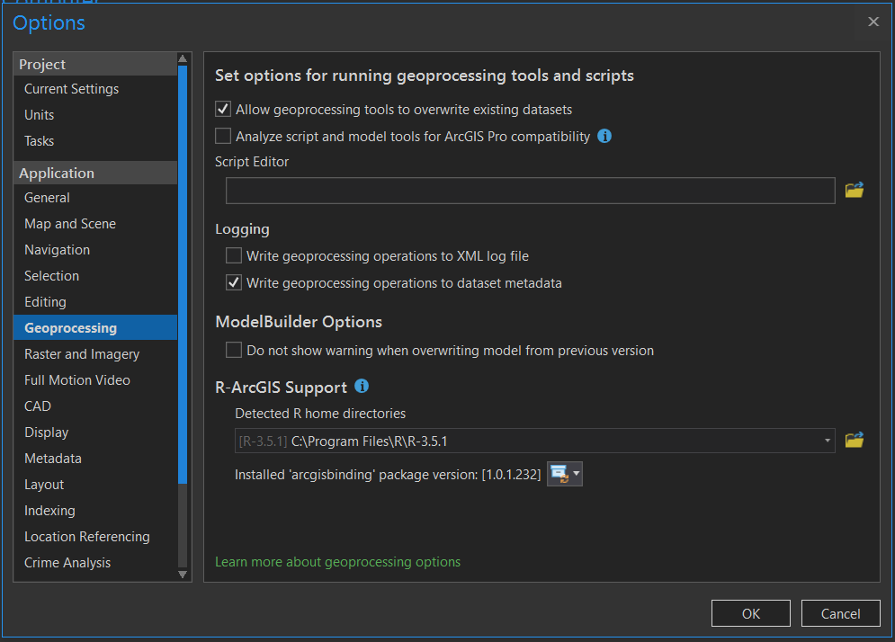
Set Up
The R-ArcGIS Bridge
Requires:
ArcGIS Pro 1.1 or later
R 3.2.2 or later
R “sp” package
Rstudio (optional)

Slide 24
ArcGIS A Platform for Developers
Major Advancements
JavaScript
Runtime
Python Web Scripting
Pro Customizations
Python
API
Runtime SDKs
JavaScript
API
HTML5
Python
C#
.NET
Open Development and Scripting Tools
Java
Kotlin
Xamarin
Qt
C++
JavaScript
REST
Swift
For Devices, Web, and Desktop
Objective-C
ArcGIS Developer Program
Supporting Enterprise Developers . . .
and the Creative “Maker” Community
Notes:
Eric

Slide 25
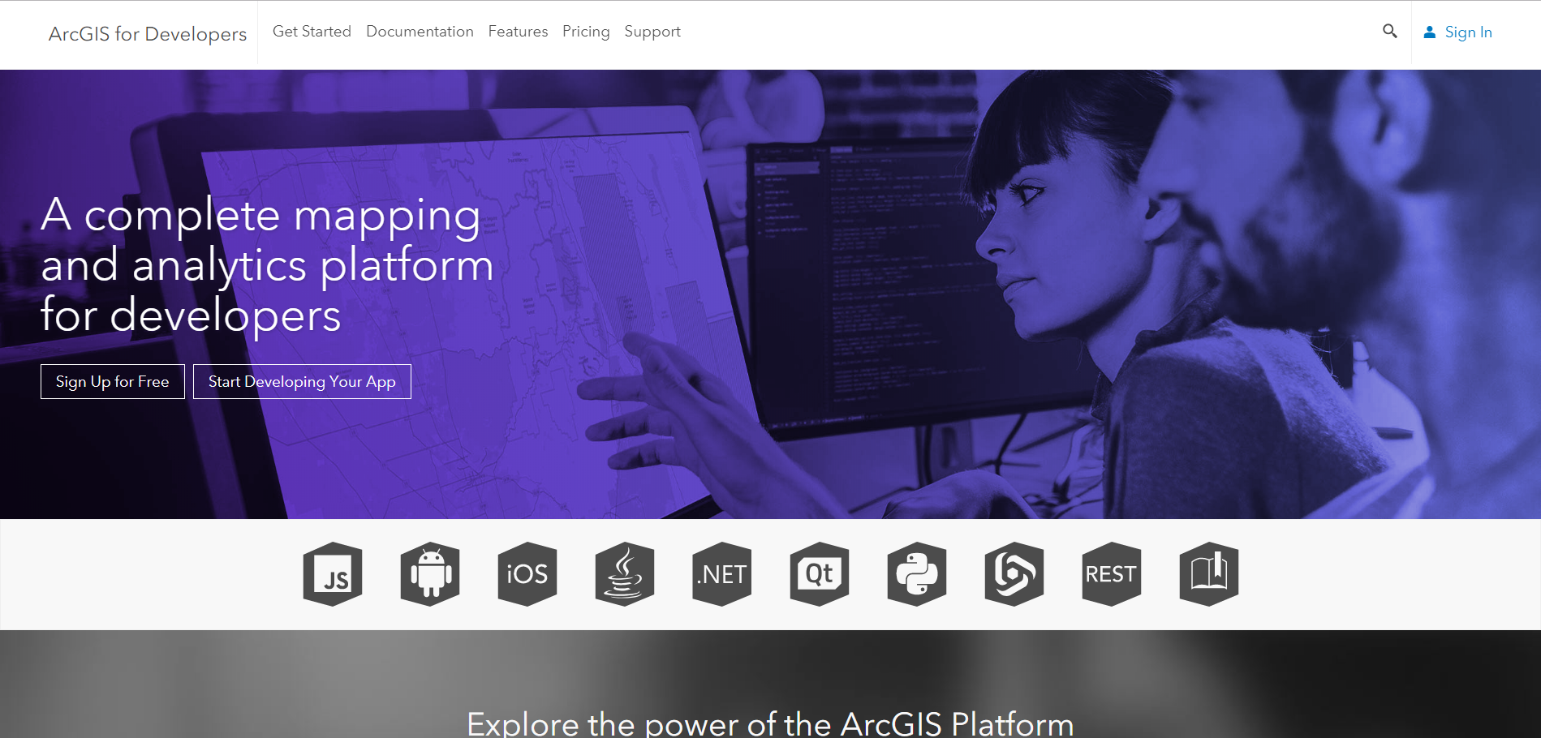
Developers Resources
Getting started with developer tools
developers.arcgis.com
Broken down by language
API References
Programming Concepts
Dev Labs
10-15min introductions
Download APIs/SDKs

Slide 26

Defense Developer Series
http://bit.ly/2J1KKhe
June 27– Working with Offline Data
Aug 15– Military Symbology
Sep 19 – Build Analysis into Your Applications
Oct 17 – Working with Offline Data
Learn more about applying ArcGIS SDKs and APIs to defense application development

Slide 27

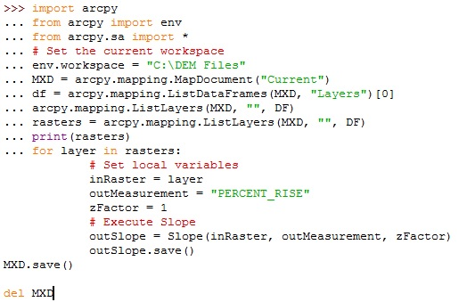
ArcGIS API for Python
Setup
Two ways to implement
Host in own anaconda environment
Host through ArcGIS Pro
Modules of interest:
GIS: interact with Portal
Feature: interact with feature classes
GeoAnalytics: interact with geoanalytic server
Geometry: interact with/create geometries
Mapping: visualization in webapps
MapView: visualization in jupyter
Full API reference on developers.arcgis.com

Slide 28
ArcGIS API for Python
Setup
Two ways to implement
Host in own anaconda environment
Install in anaconda package manager
Package is called “arcgis”
Host through ArcGIS Pro
Python is automatically installed with ArcGIS Pro along with jupyter notebook
Useful for scripting/automating tasks
These scripts can be turned into tools
Can be used to integrate in with other analytical libraries
Full API reference on developers.arcgis.com

Slide 29
Host ArcPy
Which option should I choose?
Anaconda
ArcGIS Pro
Can install it with ArcGIS Pro
Can install it with ArcGIS Pro

Slide 30
Artificial Intelligence
Video Game Behavioral AI
Natural Language Processing
Computer Vision
Machine
Learning
Robotics
Keras
Theano
CNTK
TensorFlow
IBM
Watson
scikit-learn
Deep
Learning
Convolutional Neural Networks

Slide 31
Artificial Intelligence
Video Game Behavioral AI
Natural Language Processing
ArcGIS
Computer Vision
Machine
Learning
Robotics
Keras
Theano
CNTK
TensorFlow
IBM
Watson
scikit-learn
Deep
Learning
ArcGIS
Integration

Slide 32
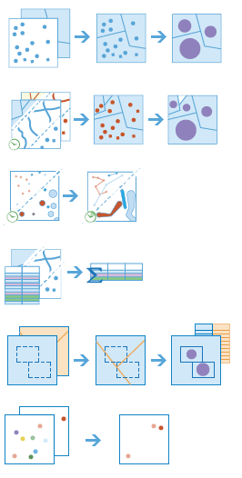
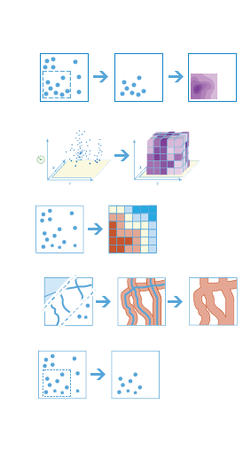
Machine Learning Tools in ArcGIS
Classification
Prediction
Maximum Likelihood Classification
Random Trees
Support Vector Machine
Empirical Bayesian Kriging
Areal Interpolation
EBK Regression Prediction
Ordinary Least Squares Regression and Exploratory Regression
Geographically Weighted Regression
Clustering
Spatially Constrained Multivariate Clustering
Multivariate Clustering
Density-based Clustering
Image Segmentation
Hot Spot Analysis
Cluster and Outlier Analysis
Space Time Pattern Mining

Slide 33






Machine Learning Integration with External Frameworks
Apps
Desktop
APIs
ArcGIS

Slide 34
ArcGIS Enterprise Overview

Slide 35


ArcGIS Enterprise is a full-featured mapping, analytics and data management platform that runs on infrastructure you control, enabling you to visualize, interpret, and act upon your location-based data.

Slide 36


When we talk about Web GIS we are talking about an end-to-end experience – not just a REST service.
ArcGIS Enterprise
ArcGIS Online

Slide 37



ArcGIS Online
ArcGIS Pro
ArcGIS Apps
ArcGIS Enterprise
ArcGIS for Developers

Slide 38
Components of ArcGIS Enterprise
ArcGIS Server
Portal for ArcGIS
ArcGIS Data Store
ArcGIS
Web Adaptor
Relational
Tile Cache
Spatiotemporal

Slide 39
Server Licensing Roles
ArcGIS Server
GIS Server
GeoEvent Server*
Image Server
GeoAnalytics Server
One software component, multiple server roles
A role = functionality + service types
Role-based licensing allows you to dedicate hardware to server functionality

Slide 40
ArcGIS GeoAnalytics Server uses the power of distributed computing to quickly process and analyze vector and tabular data with both spatial and temporal components.

Slide 41
GeoAnalytics Server
Answer difficult questions involving large volumes of data in minutes or hours instead of days or weeks
Distributed processing
and distributed storage
Rich geoinformation model of ArcGIS Enterprise
Powerful analytics

Slide 42
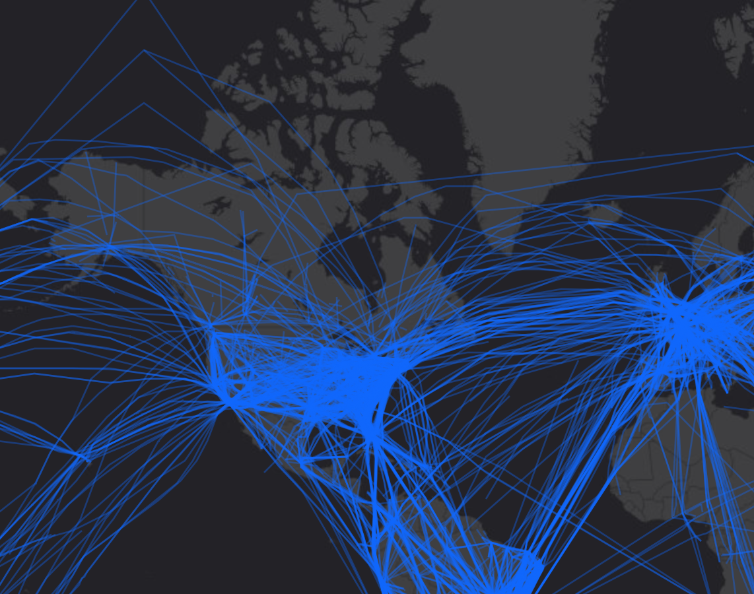
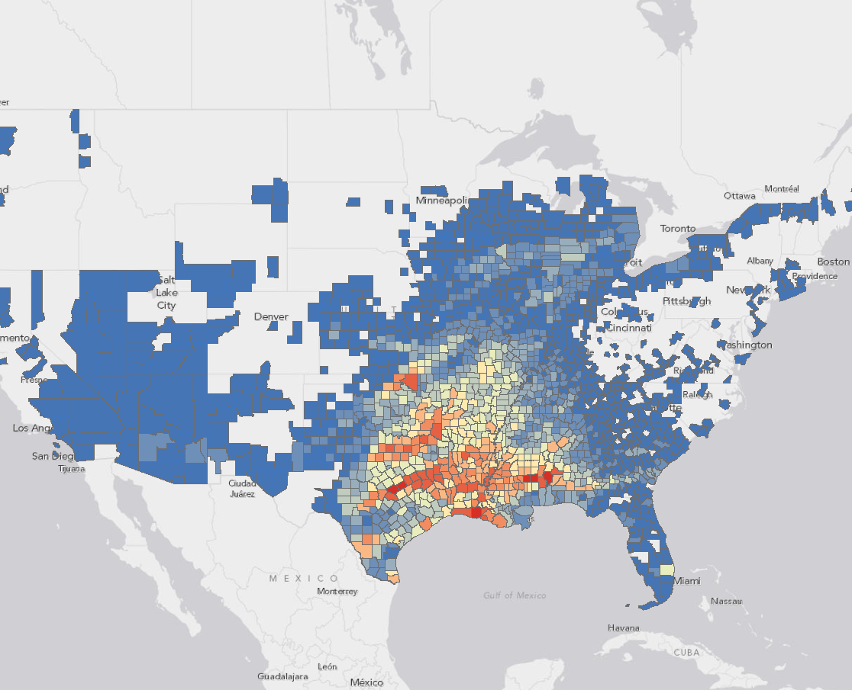
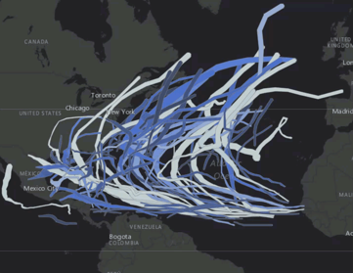
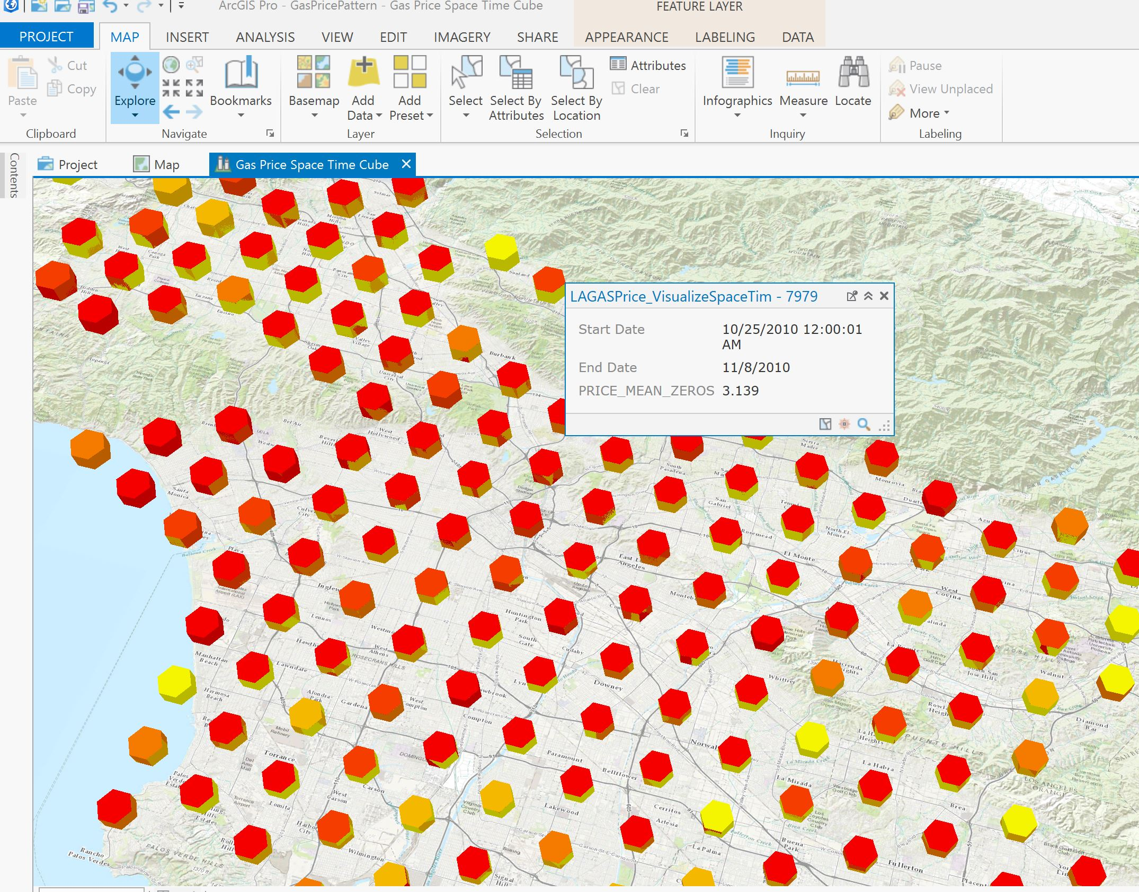
Analysis Capabilities
Summarize Data
Analyze Patterns
Find Locations
Aggregate Points
Join Features
Reconstruct Tracks
Summarize Attributes
Summarize Within
Detect Incidents
Find Similar Locations
Geocode Locations
Calculate Density
Create Space Time Cube
Find Hot Spots
Manage Data
Use Proximity
Calculate Field
Copy to Data Store
Create Buffers

Slide 43
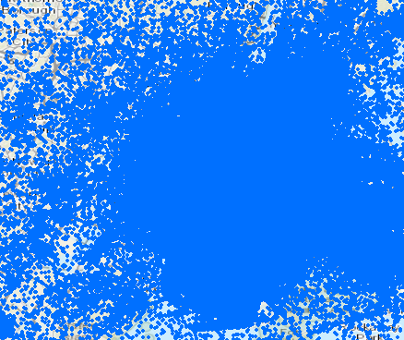
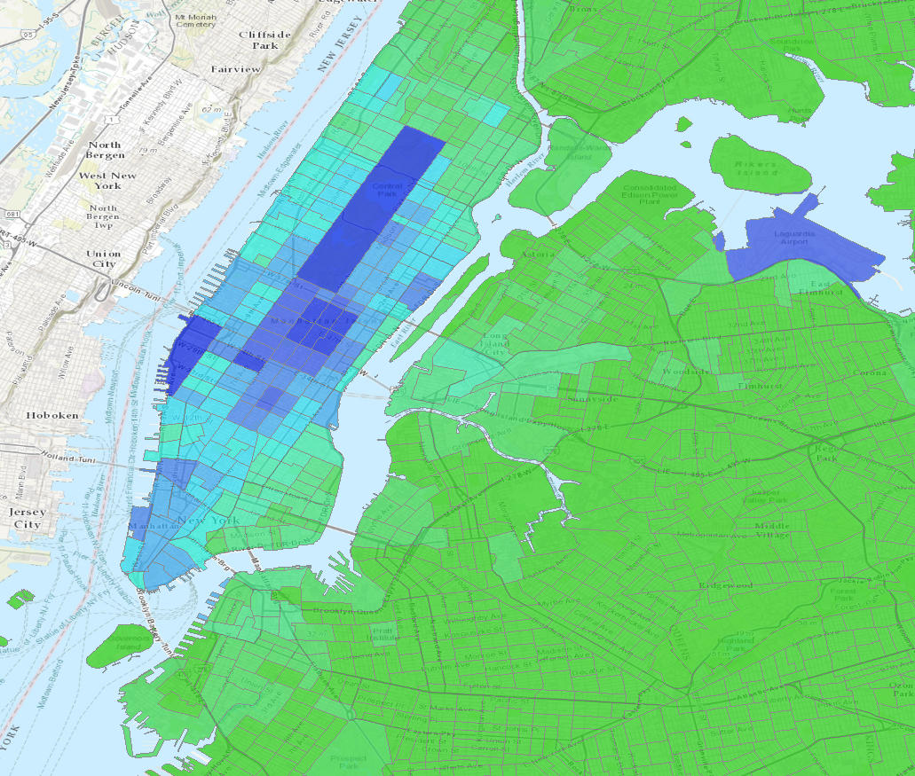
Analysis Capabilities
Familiar GIS tools powered by distributed computing
Perform common spatial analysis workflows at scale
Visualize large volumes of data using summarization tools

Slide 44
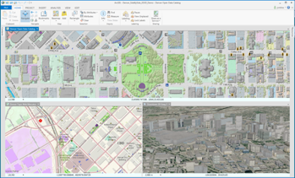
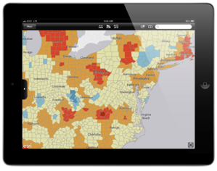
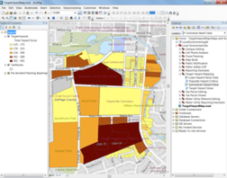
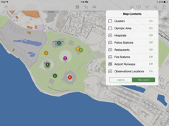
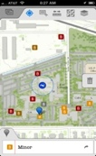
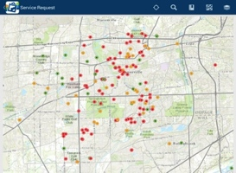


The ArcGIS Platform
ArcGIS Desktop
Apps
APIs & SDKs
http:
http:
http:
Maps
Scenes
ArcGIS for Server
including Portal
ArcGIS Online
Analytics
Feature
Layers
Scene Layers
Tile
Layers
Image
Layers
Analytics
Services
Data

Slide 45
Web Maps – Integrate Information / Configure / Share
Source Materials
Apps
User Needs
Desktop
Spreadsheet
Web Map
Dashboards
Operational Awareness
Databases
CSV
Sensor & Real-Time Data
3D Data
Mobile Apps
Field Mobility
Templates
Imagery
Drone Video Feeds
Public Engagement
Data from ArcGIS Online
Web Apps
Basemaps

Slide 46
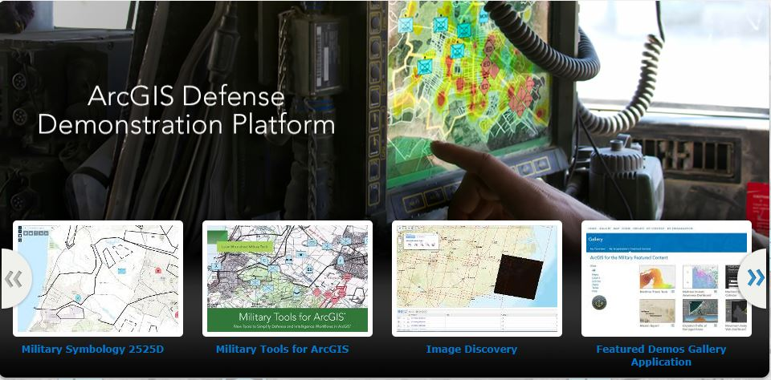
Portal for ArcGIS
Portal
Browse, search, and discover your GIS assets
Self-service mapping
Content creation and management
Sharing and collaboration
Data hosting and mapping
Visualization, collection, and analysis
Ready to use maps and layers

Slide 47
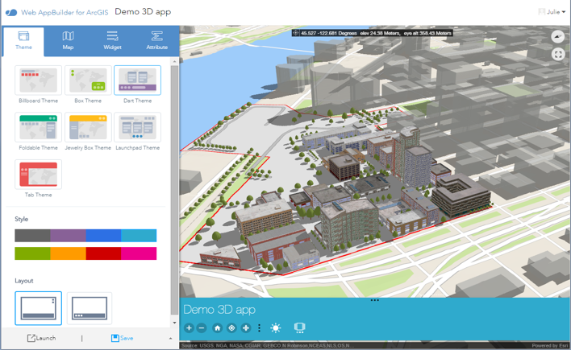
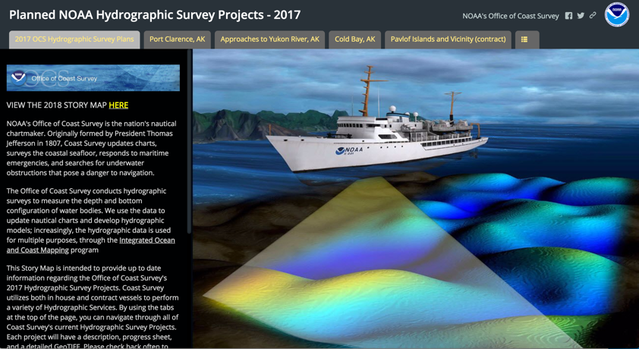
App Builders
Configurable Apps
Web AppBuilder
Story Maps

Slide 48
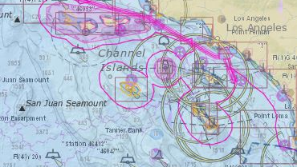
Demo Portal for ArcGIS
John Fry

Slide 49


